Slide 1


Deepfakes Detection
Hala Zayzafoun,
Tamás Bukits,
Bolutife Atoki

Slide 2

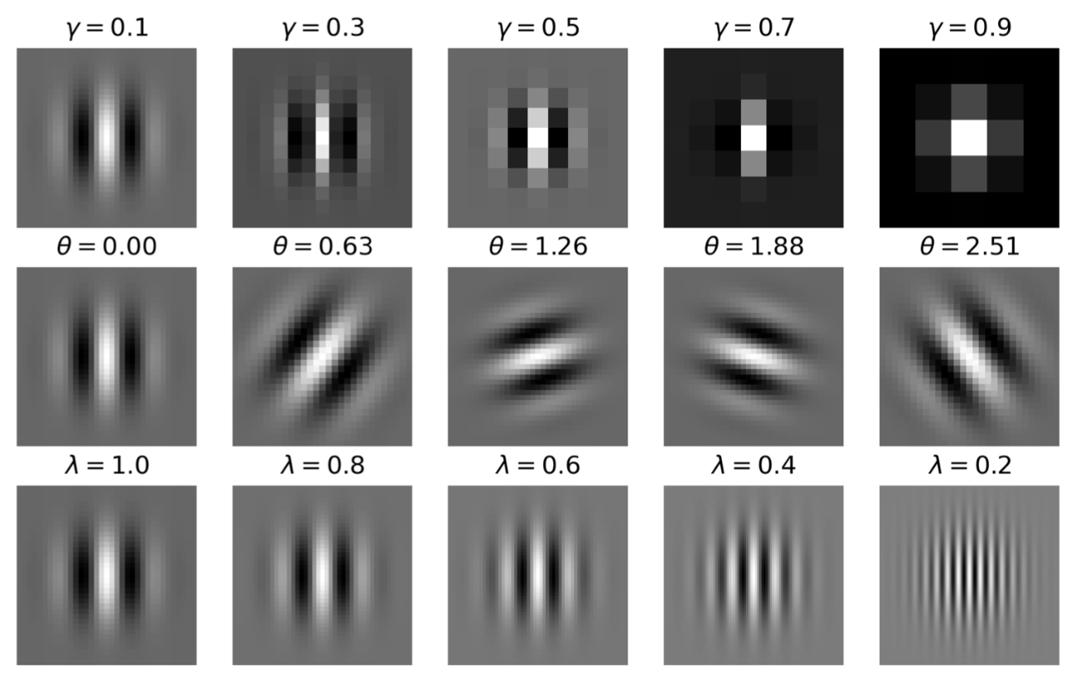
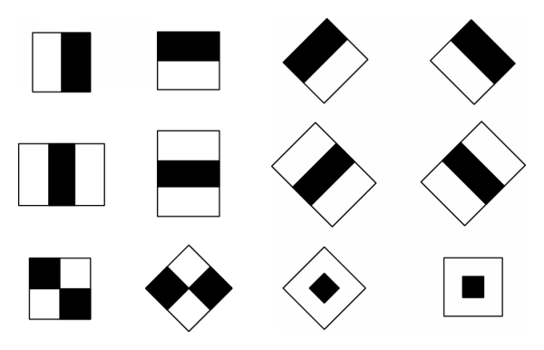
Pipeline – From Scratch!
Face Detection
Processing
Reszing to 60 x 60
Feature Extraction
Model and training
Predection

Slide 3
Face detection
The face has several features that can be identified, like eyes, mouth, nose via Landmark Detection
Robust face detection was implemented with two Face Detectors:
Landmark Detection
Dlib’s Face recognition [1]
Face Detection
[1]: Detecting Face Features with Python (livecodestream.dev)

Slide 4

Face detection
In case multiple faces we detected the closest one

Slide 5
Processing
To pass faces to CNN, uniform face sizes were required.
Batch resizing of face images to 60 x 60 was performed.
Processing

Slide 6
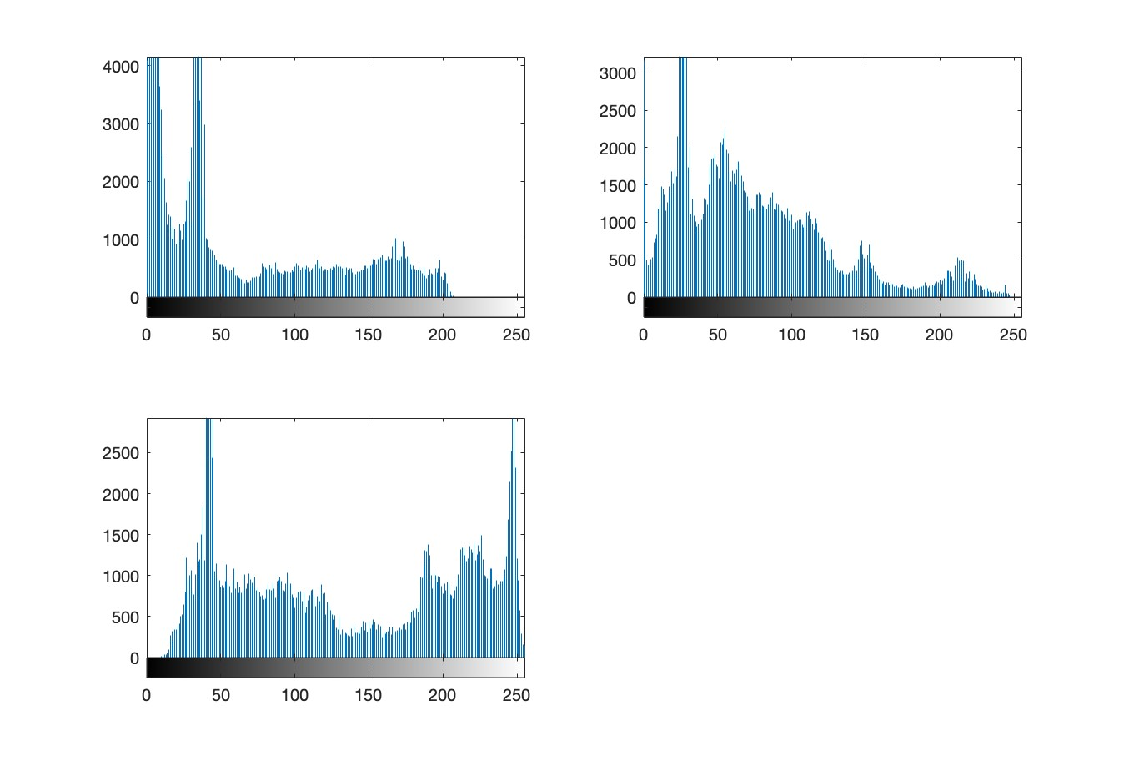
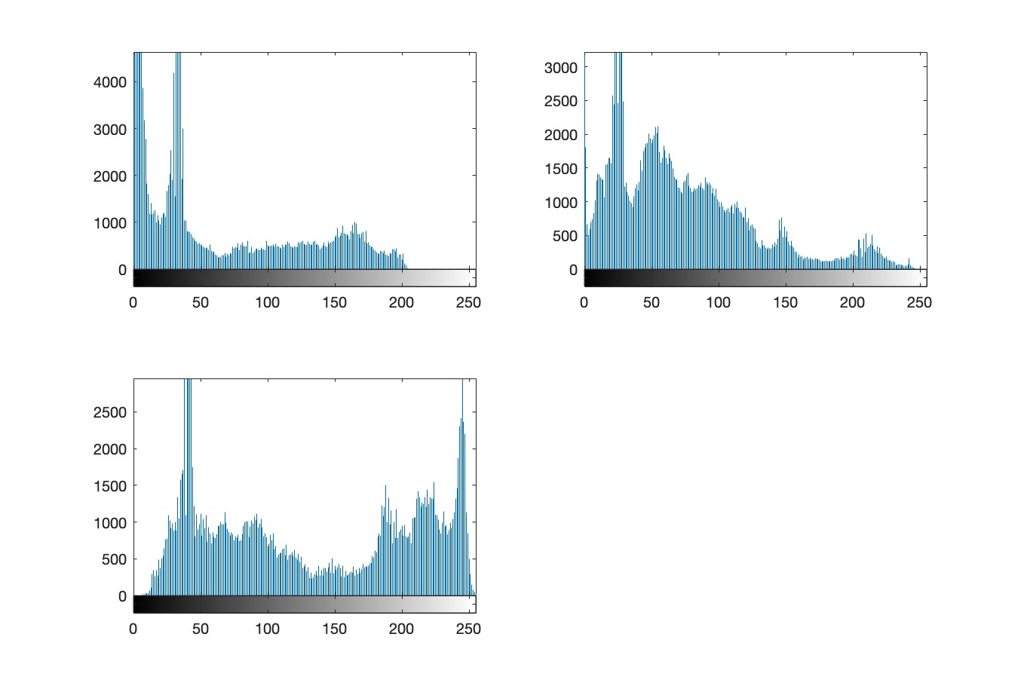
Initial Approaches
Database Analysis via Histogram
Histogram of Real Image
Histogram of Fake Image
No differences between Real and deepfakes in all three colour channels!

Slide 7
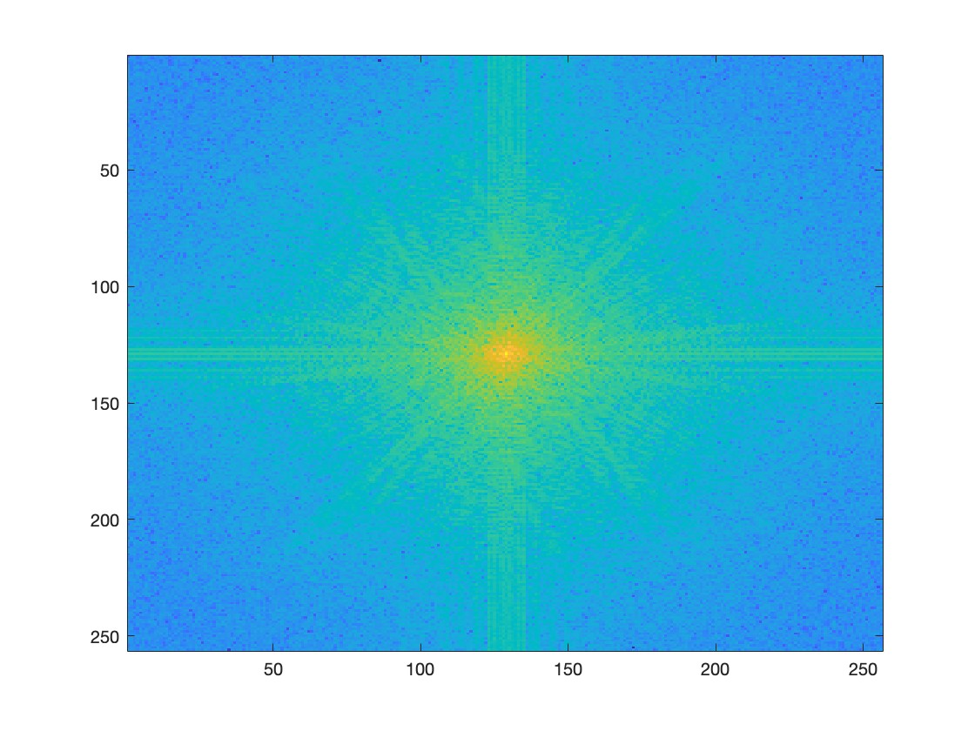
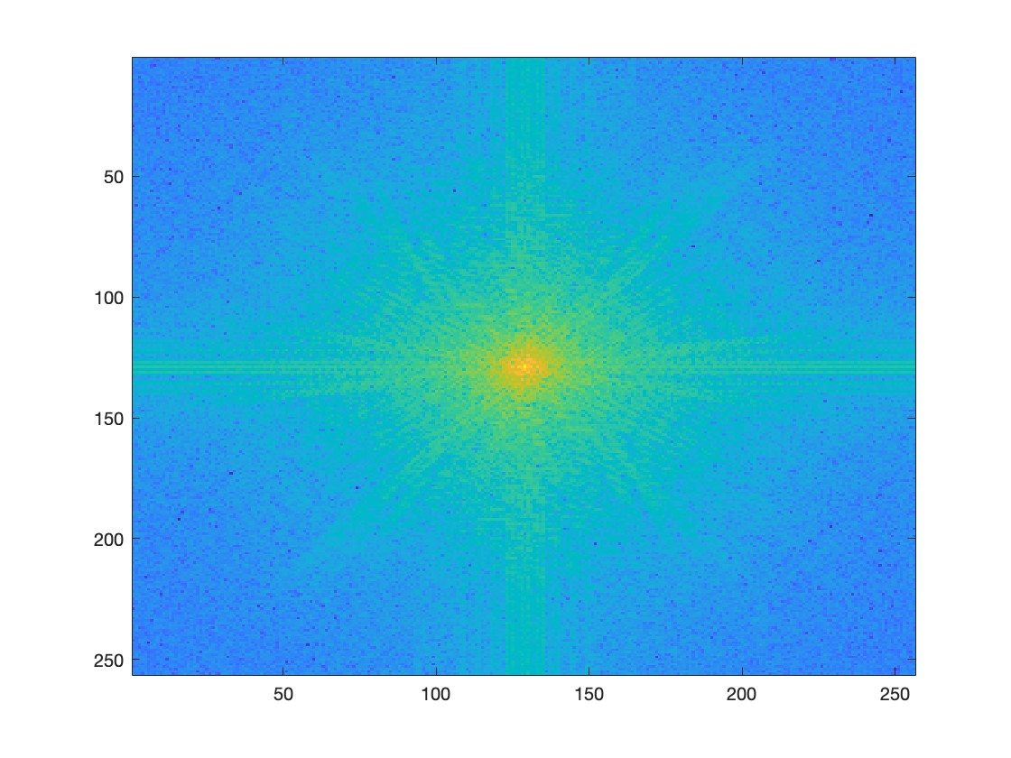
Initial Approaches
Database Analysis via Frequency Component
Real Image in frequency domain
Fake Image in frequency domain
Slight differnces but not enough for discrimination

Slide 8
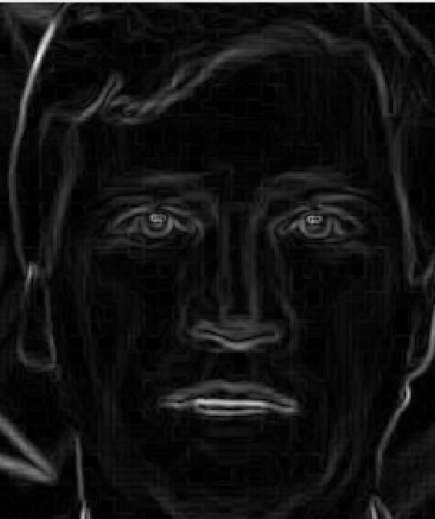
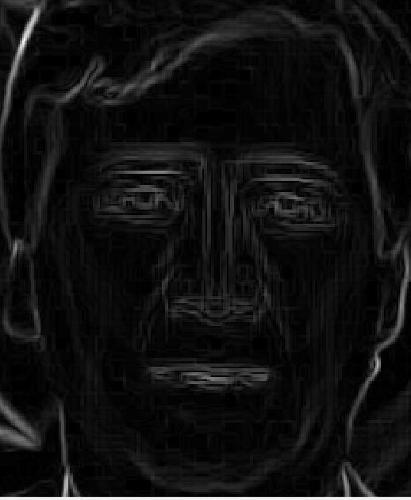
Initial Approaches
Database Analysis via Gradient Images
Real Image with less gradients
Deepfake Image with much more gradients

Slide 9
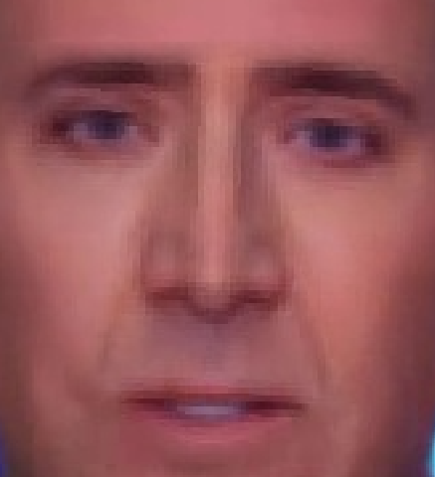
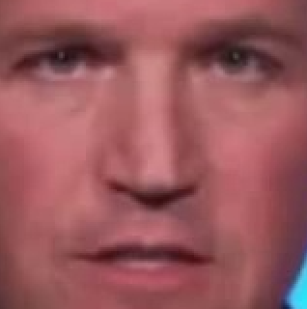
Feature extraction
Feature Extraction
We can see that in the face image there are a lot of artifacts around the nose, eyes and mouth
Fake Image
Real Image

Slide 10
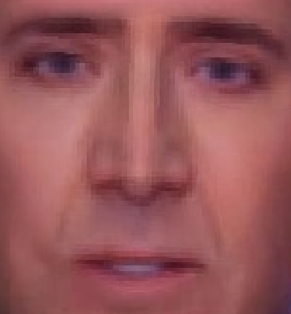
Feature extraction
Haar filter [1]
Gabor filter [2]
[1]: https://docs.opencv.org/3.4/d2/d99/tutorial_js_face_detection.html
[2]: https://ieeexplore.ieee.org/document/6623443

Slide 11
Initial Model Architecture
Training models on Handcrafted features alone
Statistical Classifier | Accuracy
KNN Classifier | 0.84
SVC | 0.828
Logistic Regression | 0.747
Decision Trees | 0.803
Naive Bayes | 0.823
Accuracy results on evaluation set

Slide 12
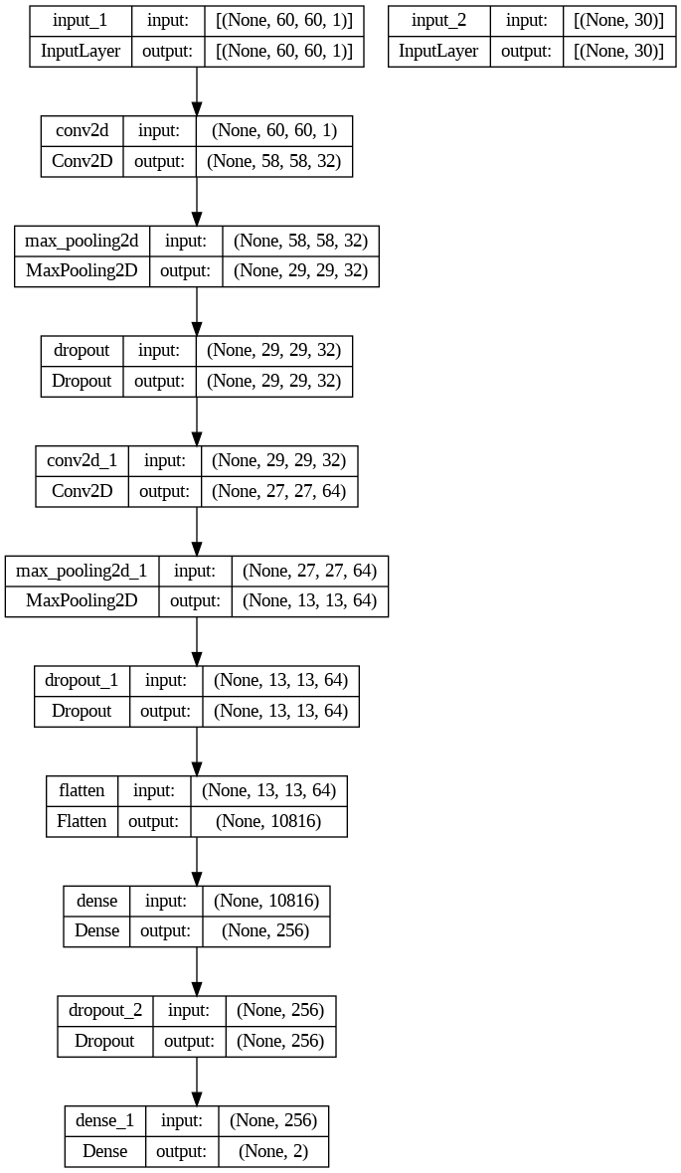
Final Model Architecture
Two input layers
Input Layer 1: Resized 60x60 face image for CNN feature extraction
Input Layer 2: 30 Extracted Handcrafted features using HAAR and Gabor filters
Output layer
Results of prediction per frame

Slide 13
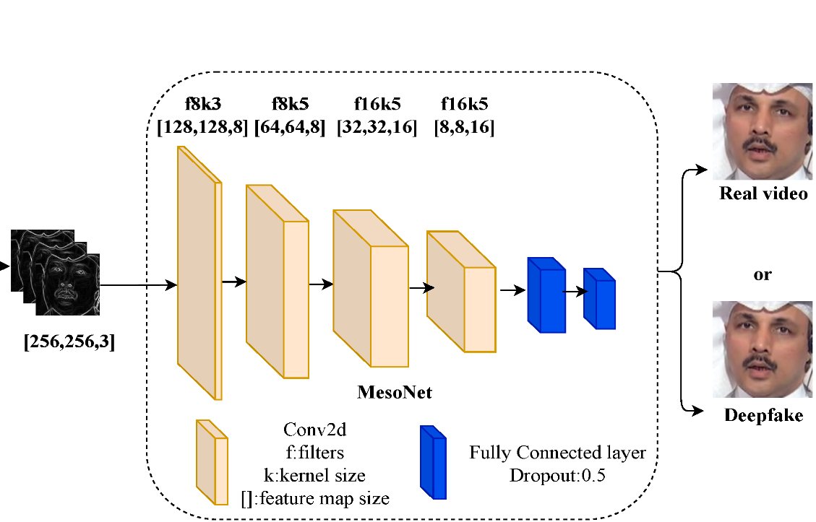
MesoNet architecture

Slide 14
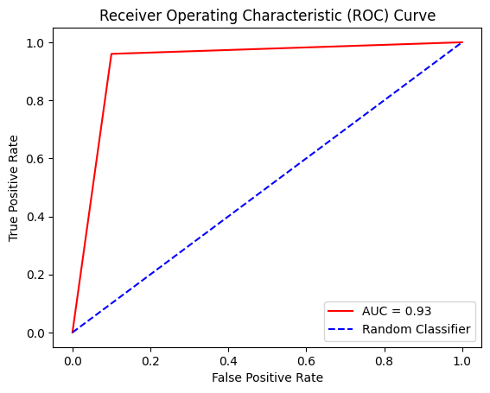
Results
Task 1 Evaluation
Evaluating UADFV (evaluation) dataset using Model trained on UADFV dataset
 | Model
Actual | 99 | 11
 | 4 | 96
ROC Curve
Confusion Matrix

Slide 15
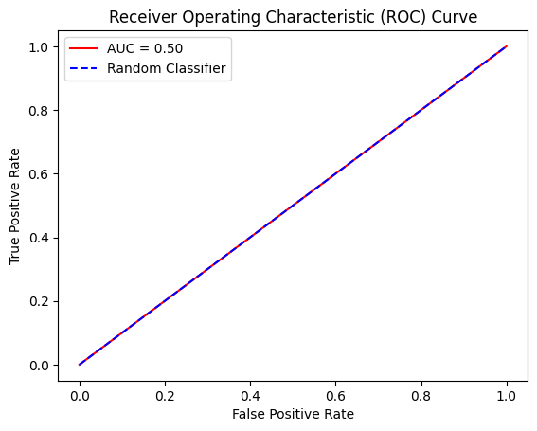
Results
Task 2 Evaluation
Evaluating CELEBDF dataset using Model trained on UADFV dataset
 | Model
Actual | 181 | 119
 | 181 | 119
ROC Curve
Confusion Matrix

Slide 16
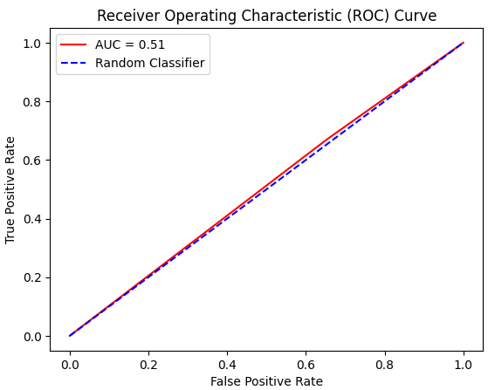
Results
Task 3 Evaluation
Evaluating CELEBDF dataset by testing on pre-trained MesoNet Model. [1]
 | Model
Actual | 90 | 210
 | 83 | 217
ROC Curve
Confusion Matrix
[1]: https://github.com/DariusAf/MesoNet

Slide 17
Conclusion
The first task proved that a combination of Handcrafted and Deep learning features provide better results as the AUC of statistical classifiers trained only on Handcrafted features was 0.84, compared to 0.93 obtained via the fusion
Performance of Deepfake detection models depends significantly on the similarity between the training and the evaluation dataset
Training Deepfake detection models on frames from a sequence of files would aid model performance as prediction is not done on just a single frame, but on a couple of frames in the sequence.

Slide 18
Thank you!
18

